Slide 1

Behind the Scenes of GENI Experimentation

Slide 2
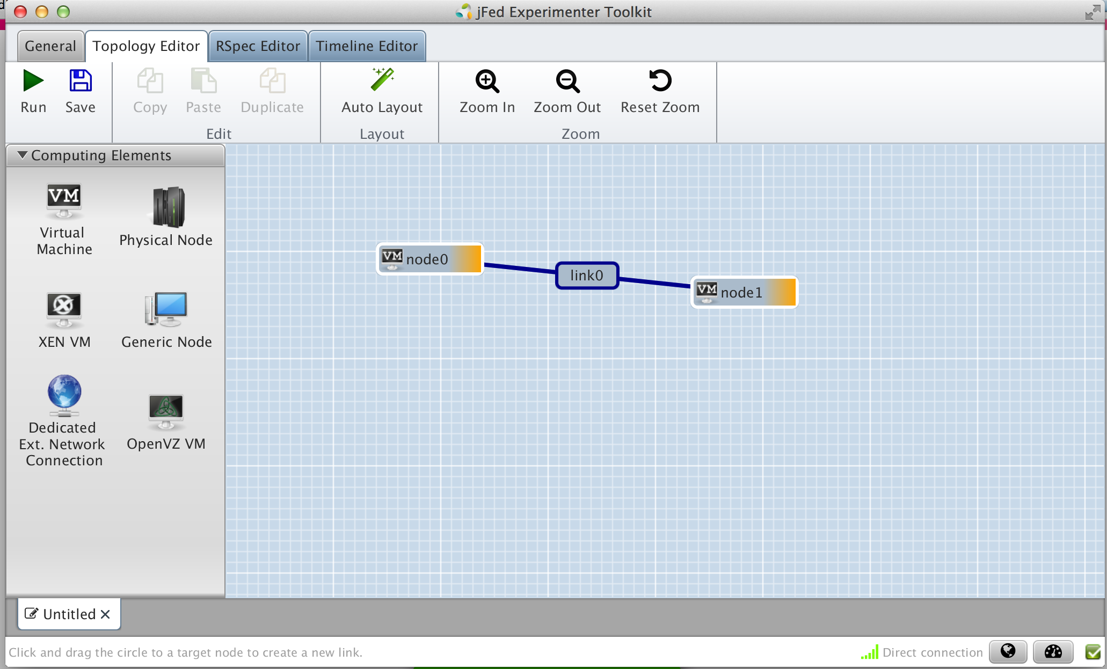
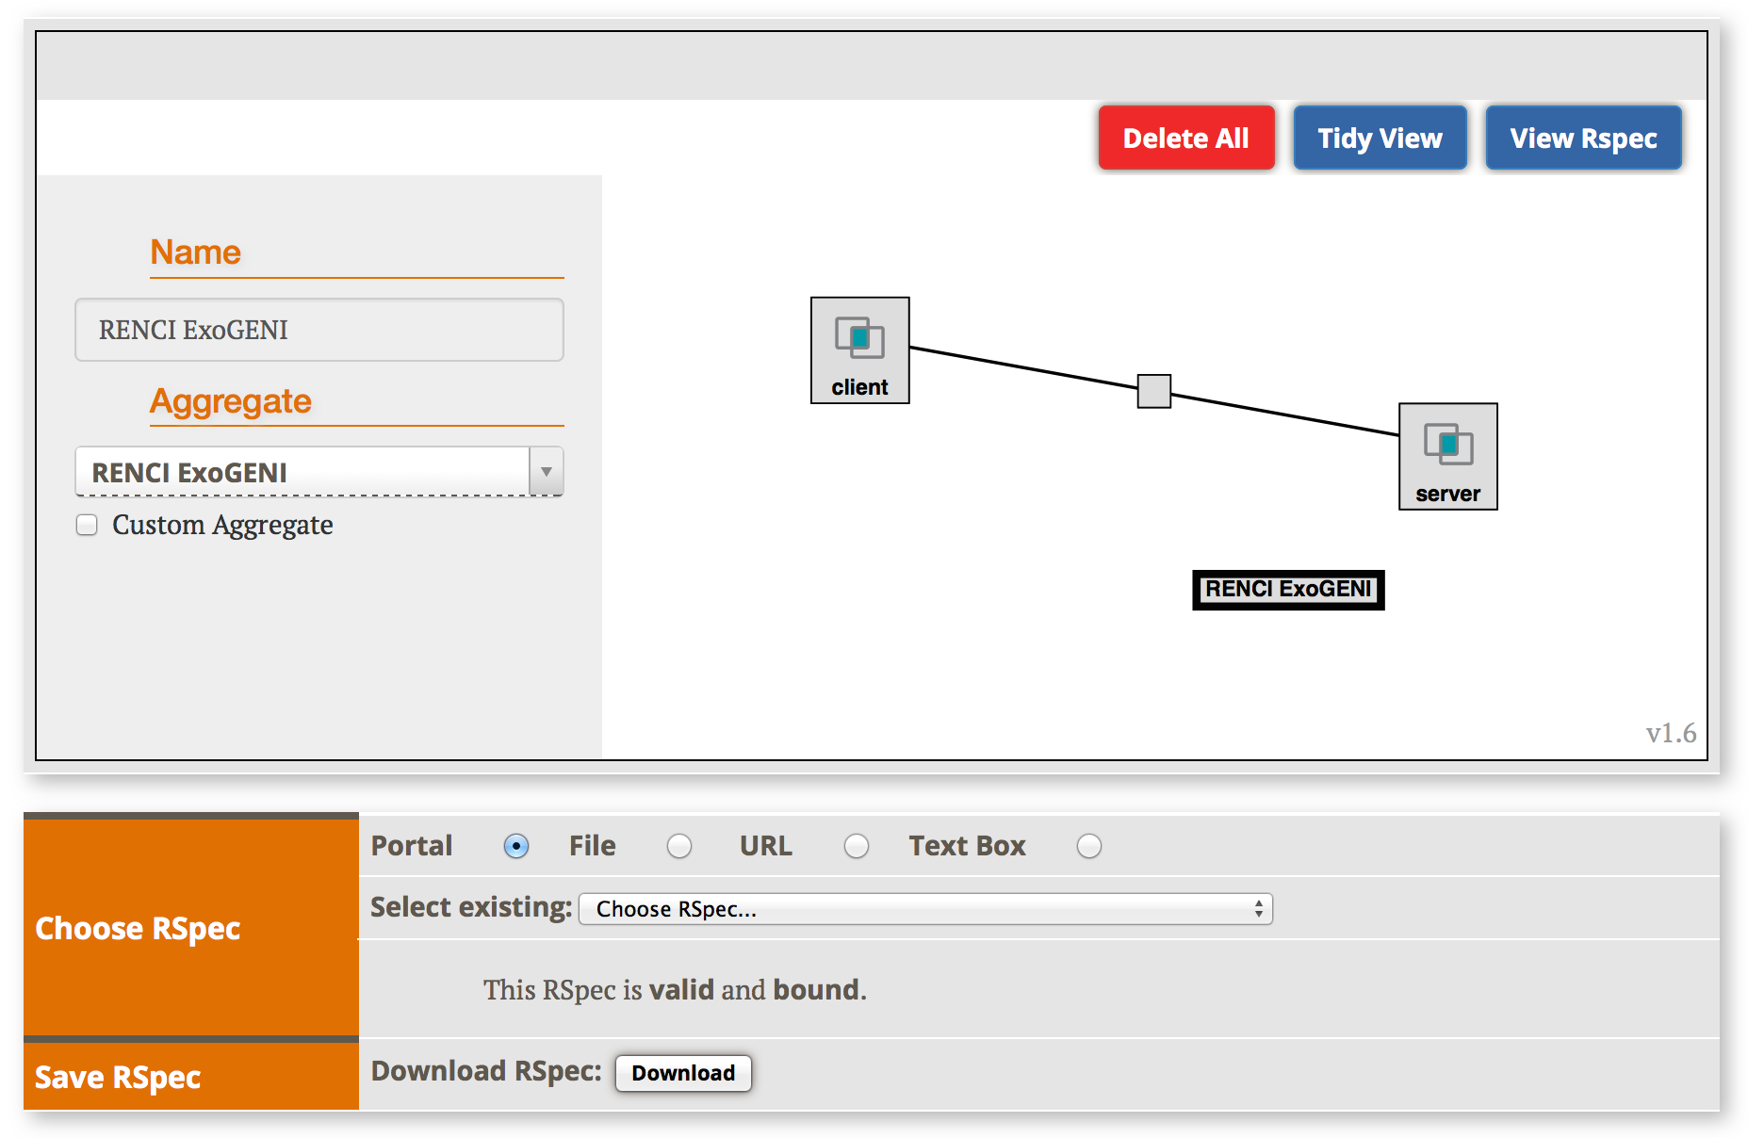
In Part 1 You Learnt…
To run a simple experiment
  Logging into the Portal
  Using a tool such as Jacks or jFed to reserve resources
  Logging into resources
  Manually installing software in resources
Control interface vs. data interfaces
jFed
Jacks

Slide 3

In Part 2 You will Learn…
What happens behind the scenes when you run an experiment on GENI
New concepts:
  GENI Resource Specifications (RSpecs)
  GENI Aggregate Manager API (GENI AM API)

Slide 4
Tutorial Objectives
By the end of this tutorial you should:
  Feel comfortable running experiments on GENI
  Have a basic understanding of how GENI works
Later exercises may skip some of the basic steps in this tutorial to focus on new material
  You may be given an RSpec to use rather than have you create one
  You may use slices that have already been created and resources added to them
For a description of the GENI concepts covered, see:
http://groups.geni.net/geni/wiki/GENIConcepts

Slide 5
GENI Resource Specifications (RSpecs)
RSpecs are XML documents that describe resources
  VMs, links, etc.
RSpec for a virtual machine with one interface:
<?xml version="1.0" encoding="UTF-8"?>
<rspec type="request” xsi:schemaLocation="http://www.geni.net/resources/rspec/3 … xmlns="http://www.geni.net/resources/rspec/3">
<node client_id="server" component_manager_id="urn:publicid:IDN+instageni.gpolab.bbn.com+authority+cm”>
<sliver_type name="emulab-openvz"/>
<interface client_id="server:if0”> </interface>
</node>
</rspec>

Slide 6
RSpecs
RSpec documents are exchanged by experimenter tools (e.g. Flack) and aggregates
  Aggregates use RSpecs to describe what they have – Advertisement RSpecs
  Experimenters use RSpecs to describe the resources they want – Request RSpecs
  Aggregates use RSpecs to describe the resources allocated to an experimenter – Manifest RSpecs

Slide 7

The GENI AM API
Experimenter tools and aggregates talk to each other using the GENI Aggregate Manager API (GENI AM API)
What do you have?
I have …
ListResources(…)
I would like …
Advertisement RSpec
You have …
CreateSliver(Request RSpec, …)
Aggregate
Manager
Experimenter
Tool
What do I have?
Manifest RSpec
You have …
ListResources(SliceName, …)
Manifest RSpec

Slide 8
Putting it all Together…
When you drag and drop resources on to the Jacks/jFed canvas, a request RSpecs for these resources is created
  To view the request RSpec…
When you click Add Resources/Run, createSliver is called on the aggregates
I would like …
jFed
Jacks

Slide 9
Putting it all Together…
Tool periodically calls sliverStatus on the aggregates to check on the status of your request
When sliverStatus shows:
  Resources are ready to use, when they turn green
jFed
Jacks

Slide 10
Putting it all Together…
What do I have?
ListResources with a slice name returns a manifest RSpec
Manifest includes names and ports used to ssh into VMs
  Tool uses this information to help you log into your resources
You have …
jFed

Slide 11
Putting it all Together…
When you delete resources, tool calls deleteSliver on aggregates

Slide 12
Omni: Resource Reservation tool
A command line experimenter tool
Useful for making AM API calls on aggregates
Written in and scriptable from Python
Works with aggregates that implement the GENI AM API
  InstaGENI and ExoGENI racks, ProtoGENI, PlanetLab, FOAM (OpenFlow AM)
$ omni.py createsliver aliceslice myRSpec.xml
INFO:omni:Loading config file omni_config
INFO:omni:Using control framework pgeni
INFO:omni:Slice urn:publicid:IDN+pgeni.gpolab.
expires within 1 day on 2011-07-07
INFO:omni:Creating sliver(s) from rspec file
INFO:omni:Writing result of createsliver for
INFO:omni:Writing to ‘aliceslice-manifest-rspe
INFO:omni: -----------------------------------
INFO:omni: Completed createsliver:
Options as run:
aggregate: https://www.emulab.
framework: pgeni
native: True
Args: createsliver aliceslice myRSpec.xml
Result Summary: Slice urn:publicid:IDN+pgeni
Reserved resources on https://www.emulab.net/p
Saved createsliver results to aliceslice-man
INFO:omni: ===================================
http://trac.gpolab.bbn.com/gcf/wiki/Omni

Slide 13
Omni Command Workflow
Create
Slice
Create
Sliver
Cleanup
Repeat for each
aggregate
Repeat for each
aggregate
createslice
getversion
deletesliver
renewslice
listresources
listmyslices
createsliver
sliverstatus
Legend: AM API command

Slide 14
GENI AM API Calls Used
listresources: Get an advertisement rspec listing the resources at an aggregate
createsliver: Request resources from an aggregate
sliverstatus: Get status of resources allocated to a slice at an aggregate
deletesliver: Delete resources allocated to a slice by an aggregate
For a complete list of GENI AM API calls see:
http://groups.geni.net/geni/wiki/GAPI_AM_API

Slide 15
Corresponding Omni Commands
omni –a aggregatename listresources
omni –a aggregatename createsliver slicename requestRSpec
omni –a aggregatename sliverstatus slicename
omni –a aggregatename listresources slicename
omni –a aggregatename deletesliver slicename
A useful utility (distributed with Omni):
readyToLogin –a aggregatename slicename
  Gives you the ssh commands you need to log into your nodes
    readyToLogin.py parses the output of listresources and sliverstatus to determine the hostname, port and username for the ssh commands

Slide 16
Configuring Omni
Omni reads a configuration file omni_config to:
  Find locations of ssl certs and ssh key files
    ssl certs are used to secure communication between Omni and the aggregates
    ssh key pairs are used log into compute resources
  Find standard nicknames for aggregates
    e.g. you can refer to the InstaGENI rack at NYSERNet as nysernet-ig
      instead of
    https://instageni.nysernet.org:12369/protogeni/xmlrpc/am

Slide 17
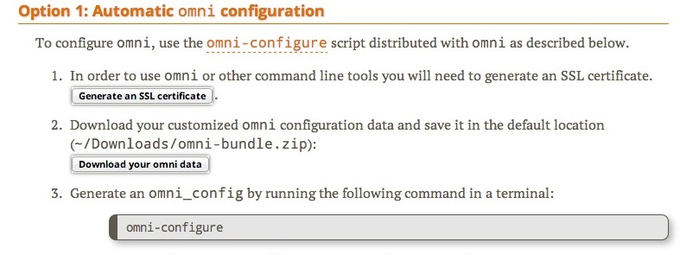
Creating an Omni Config File
Download the GENI bundle from the GENI Portal
2. Run omni-configure in a terminal window
$ omni-configure

