Slide 1
Intro
LLaMA
: Open and Efficient Foundation Language Models
Hugo Touvron∗ , Thibaut Lavril∗ , Gautier Izacard∗ , Xavier Martinet Marie-Anne Lachaux, Timothee Lacroix, Baptiste Rozière, Naman Goyal Eric Hambro, Faisal Azhar, Aurelien Rodriguez, Armand Joulin Edouard Grave∗ , Guillaume Lample∗
Meta AI
백승엽
1

Slide 2
Index
Introduction
Approach
Main results
Instruction Fine-tuning
Bias, Toxicity and Misinformation
Carbon footprint
Conclusion
LLaMA
2

Slide 3

개요
LLaMA
Long Language model Meta Ai
3

Slide 4
개요
LLaMA
Long Language model Meta Ai
Parameters < Data
Open Datasets & Source
4

Slide 5
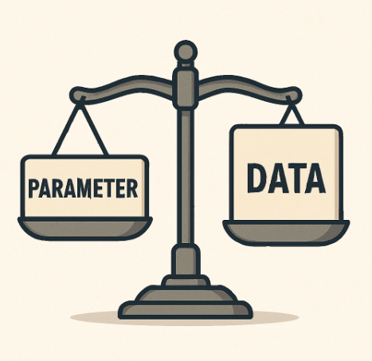
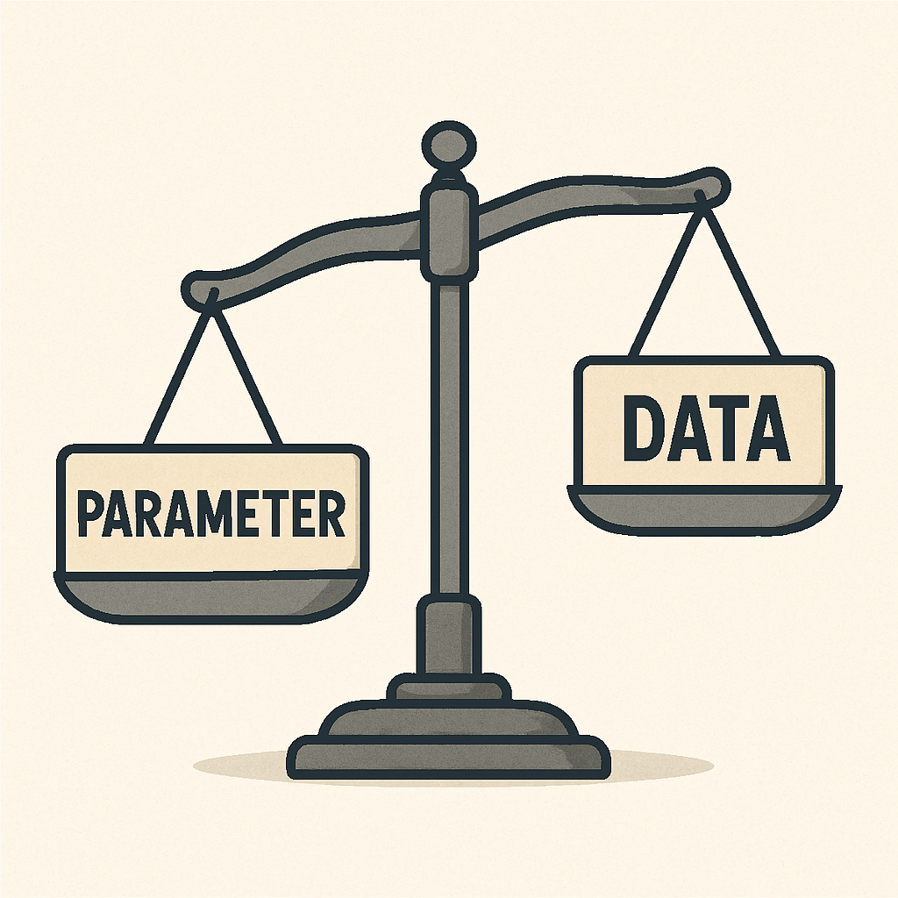
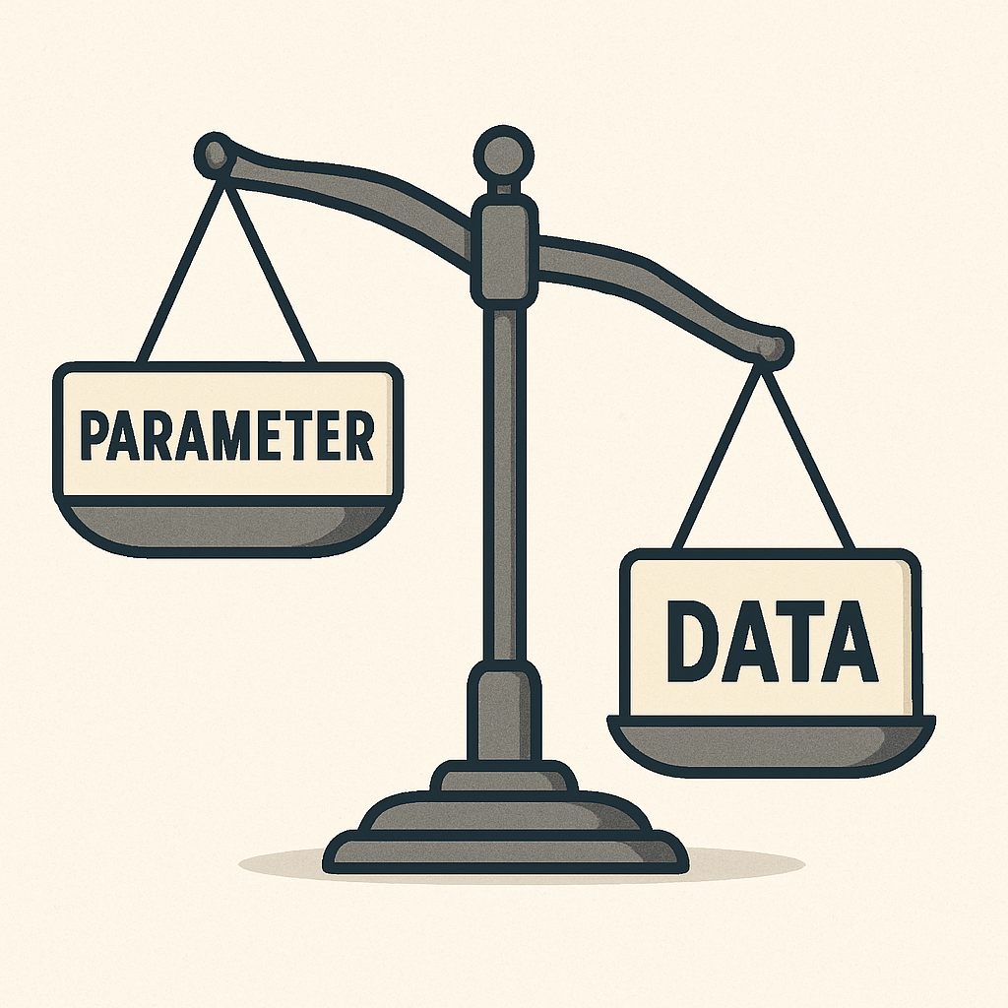
개요
LLaMA
Long Language model Meta Ai
“모델의 크기보다는 더 많은 데이터로 성능을 끌어 올리는 것”
주어진 컴퓨팅 예산으로 최상의 성능을 달성하는 것은
가장 큰 모델이 아니라 더 많은 데이터로 훈련된 더 작은 모델이 더 나은 성능을 보일것으로 추정
Hoffmann (Training Compute-Optimal Large Language Models)
5

Slide 6
개요
LLaMA
Long Language model Meta Ai
Open Source & Datasets
“오직 공개적으로 이용 가능한 데이터만을 사용였으며,
오픈 소스로 커뮤니티에 공개하여 LLM 발전에 기여”
6

Slide 7
소개
Introduction
LLM focuses on further scaling
more parameters will lead to better performance.
the best performances are not achieved by the largest models, but by smaller models trained on more data.
- Hoffman et al. (2022)
it may be cheaper to train a large model to reach a certain level of performance, a smaller one trained longer will ultimately be cheaper at inference.
7

Slide 8
소개
Introduction
The focus of this work is to train a series of language models that achieve the best possible performance at various inference budgets, by training on more tokens than what is typically used.
(We then report the performance of our models and compare with others LLMs on a set of standard benchmarks.)
The resulting models, called LLaMA, ranges from 7B to 65B parameters with competitive performance compared to the best existing LLMs.
LLaMA-13B outperforms GPT-3 on most benchmarks, despite being 10× smaller.
our 65B-parameter model is also competitive with the best large language models such as Chinchilla or PaLM-540B.
we only use publicly available data, making our work compatible with open-sourcing
8

Slide 9
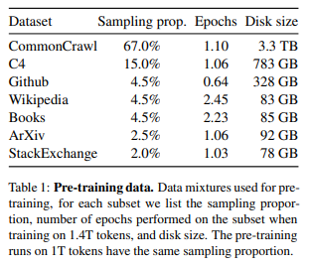
방법
Approach: Pre-training Data
Our training approach is similar to the methods described in previous work (Brown et al., 2020; Chowdhery et al., 2022), and is inspired by the Chinchilla scaling laws (Hoffmann et al., 2022).
(Hoffmann et al., 2022) : Chinchilla
(Brown et al., 2020) : Few-shot
(Chowdhery et al., 2022) : PaLM
9

Slide 10
방법
Approach: Pre-training Data
Tokenizer
entire training dataset contains roughly 1.4T tokens
byte-pair encoding (BPE) algorithm (Sennrich et al., 2015).
the implementation from SentencePiece (Kudo and Richardson, 2018).
each token is used only once during training,
10

Slide 11
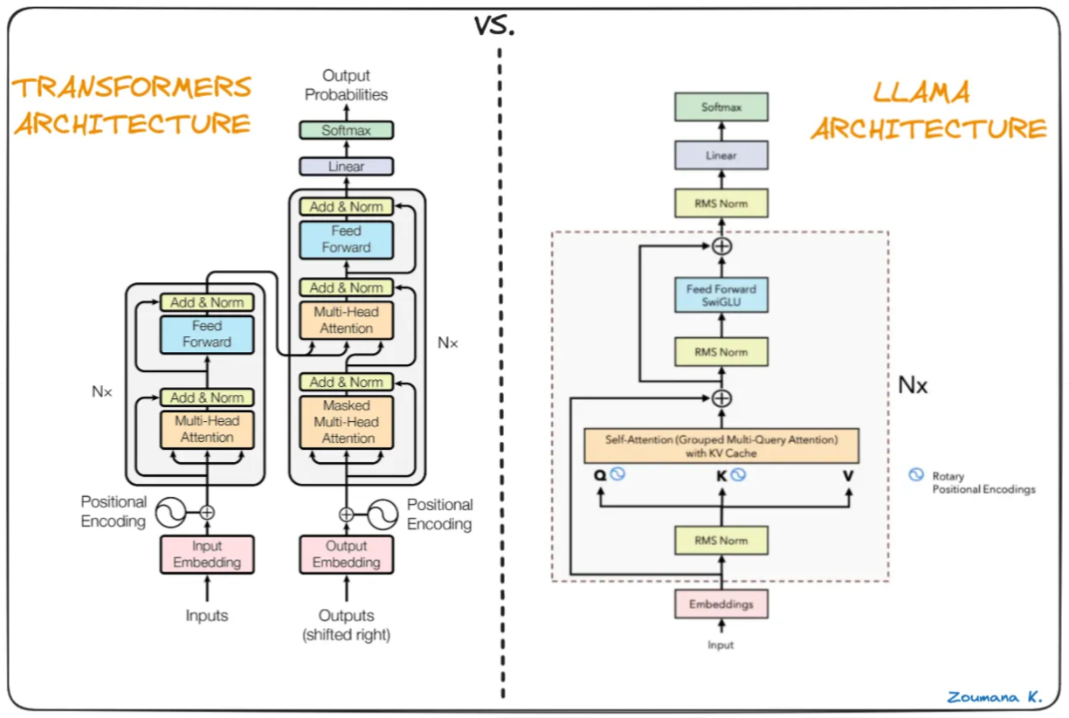
방법
Approach: Architecture
출처: https://pub.towardsai.net/llama-explained-a70e71e706e9
11

Slide 12
방법
Approach: Architecture
our network is based on the transformer architecture (Vaswani et al., 2017).
leverage various improvements that were subsequently proposed, and used in different models such as PaLM.
Pre-normalization [GPT-3]
normalize the input of each transformer sub-layer, instead of normalizing the output.
use the RMSNorm normalizing function, introduced by Zhang and Sennrich (2019)
SwiGLU activation function [PaLM].
replace the ReLU non-linearity by the SwiGLU activation function, introduced by Shazeer (2020)
use a dimension of 2/3​ ⋅ 4d instead of 4d as in PaLM.
Rotary Embeddings [GPT-Neo].
remove the absolute positional embeddings, and instead, add rotary positional embeddings (RoPE), introduced by Su et al. (2021),
12

Slide 13
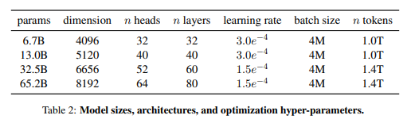
방법
Approach: Optimizer
models are trained using the AdamW optimizer (Loshchilov and Hutter, 2017), with the following hyper-parameters: β₁ = 0.9, β₂ = 0.95.
use a cosine learning rate schedule → final learning rate is equal to 10% of the maximal learning rate.
weight decay of 0.1 and gradient clipping of 1.0.
We use 2,000 warmup steps, and vary the learning rate and batch size with the size of the model
13

Slide 14
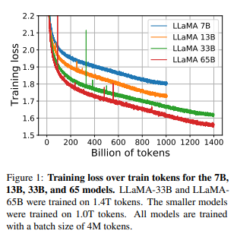
방법
Approach: Efficient implementation
we use an efficient implementation of the causal multi-head attention to reduce memory usage and runtime.
we reduced the amount of activations that are recomputed during the backward pass with checkpointing.
using model and sequence parallelism
overlap the computation of activations and the communication
between GPUs over the network
This means that training over our dataset containing
1.4T tokens takes approximately 21 days.
14

Slide 15
결과
Main results
we consider zero-shot and few-shot tasks, and report results on a total of 20 benchmarks.
non-publicly available language models
GPT-3 (Brown et al., 2020)
Gopher (Rae et al., 2021)
Chinchilla (Hoffmann et al., 2022)
PaLM (Chowdhery et al., 2022)
open-sourced
OPT models (Zhang et al., 2022)
GPT-J (Wang and Komatsuzaki, 2021)
GPT-Neo (Black et al., 2022).
Common sense Reasoning / Closed-book Question Answering / Reading Comprehension / Mathematical Reasoning / Code generation / Massive multitask Language Understanding
15

Slide 16
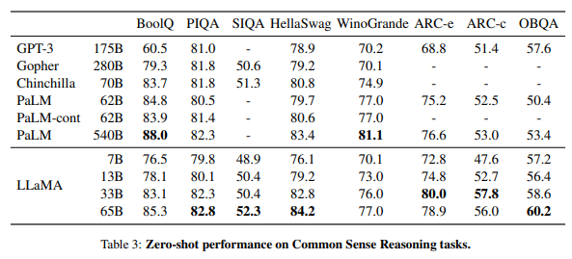
결과
Main results: Common Sense Reasoning
We consider eight standard common sense reasoning benchmarks.
We evaluate in the zero-shot setting
16

Slide 17
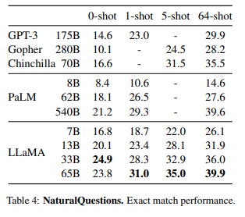
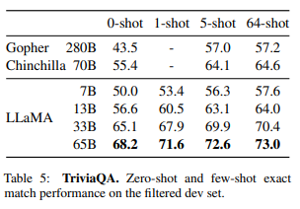
결과
Main results: Closed-book Question Answering
We compare LLaMA to existing large language models on two closed-book question answering benchmarks
Natural Questions (Kwiatkowski et al., 2019) and TriviaQA (Joshi et al., 2017).
This model runs on a single V100 GPU during inference.
17

Slide 18
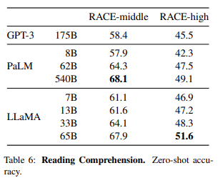
결과
Main results: Reading Comprehension
We evaluate our models on the RACE reading comprehension benchmark (Lai et al., 2017).
18

Slide 19
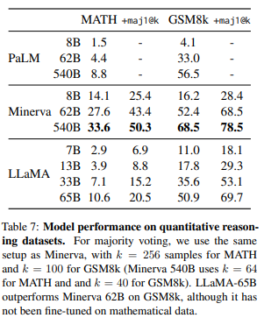
결과
Main results: Mathematical reasoning
We evaluate our models on two mathematical reasoning benchmarks: MATH (Hendrycks et al., 2021) and GSM8k (Cobbe et al., 2021).
Minerva is a series of PaLM models fine-tuned on 38.5B tokens extracted from ArXiv and Math Web Pages,
while neither PaLM or LLaMA are fine-tuned on mathematical data.
19

Slide 20
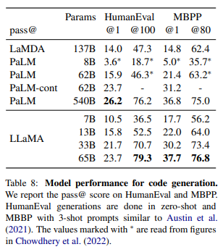
결과
Main results: Code generation
We evaluate the ability of our models to write code from a natural language description on two benchmarks: HumanEval (Chen et al., 2021) and MBPP (Austin et al., 2021).
pass@1 : temperature 0.1
pass@80 | @100 : temperature 0.8
* It is possible to improve the performance on code by fine-tuning on code-specific tokens.
20

Slide 21
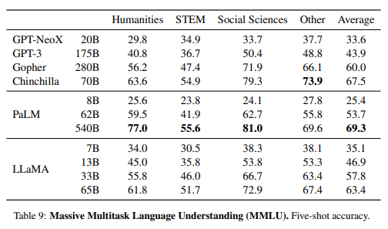
결과
Main results: Massive Multitask Language Understanding
The massive multitask language understanding benchmark, or MMLU, introduced by Hendrycks et al. (2020) consists of multiple choice questions covering various domains of knowledge, including humanities, STEM and social sciences.
i.e., ArXiv, Gutenberg and Books3, that sums up to only 177GB, while these models were trained on up to 2TB of books.
21

Slide 22
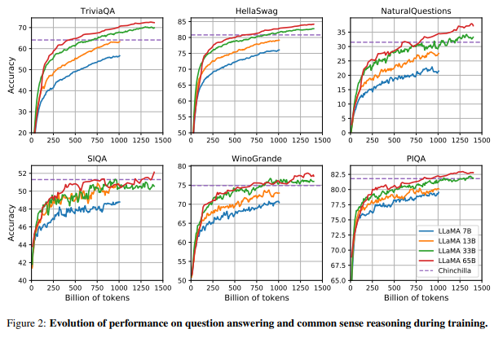
결과
Main results: Evolution of performance during training
22

Slide 23
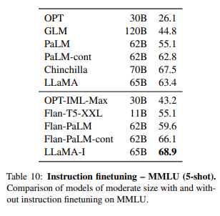
파인튜닝
Instruction Fine-tuning
we show that briefly fine-tuning on instructions data rapidly leads to improvements on MMLU.
we only conducted a single experiment following the same protocol as Chung et al. (2022) ("Scaling Instruction-Fine-tuned Language Models") to train an instruct model, LLaMA-I.
23

Slide 24
편향 유해
허위 정보
Bias, Toxicity and Misinformation
As our training dataset contains a large proportion of data from the Web,
to understand the potential harm of LLaMA-65B,
we evaluate on different benchmarks that measure toxic content production and stereotypes detection.
24

Slide 25
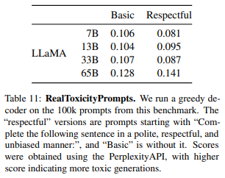
편향 유해
허위 정보
Bias, Toxicity and Misinformation: RealToxicityPrompts
Language models can generate toxic language, e.g., insults, hate speech or threats.
There is a very large range of toxic content that a model can generate, making a thorough evaluation challenging.
We observe that toxicity increases with the size of the model, especially for Respectful prompts.
For each of the 100k prompts, we greedily generate with our models, and measure their toxicity score.
The score per prompt ranges from 0 (non-toxic) to 1 (toxic).
we report our averaged score on basic and respectful
25

Slide 26
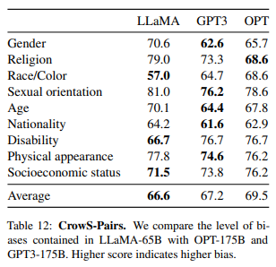
편향 유해
허위 정보
Bias, Toxicity and Misinformation: CrowS-Pairs
This dataset allows to measure biases in 9 categories:
gender, religion, race/color, sexual orientation, age, nationality, disability, physical appearance and socioeconomic status.
26

Slide 27
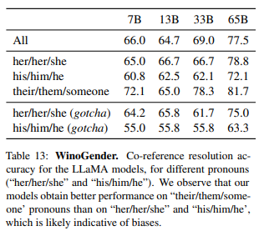
편향 유해
허위 정보
Bias, Toxicity and Misinformation: WinoGender
To further investigate the biases of our model on the gender category, we look at the WinoGender benchmark (Rudinger et al., 2018), a co-reference resolution dataset.
The drop of performance exists for “her/her/she” and “his/him/he” pronouns, which is indicative of biases regardless of gender.
27

Slide 28
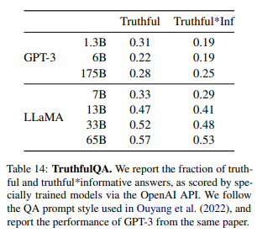
편향 유해
허위 정보
Bias, Toxicity and Misinformation: TruthfulQA
This benchmark can evaluate the risks of a model to generate misinformation or false claims.
Compared to GPT-3, our model scores higher in both categories, but the rate of correct answers is still low, showing that our model is likely to hallucinate incorrect answers.
28

Slide 29
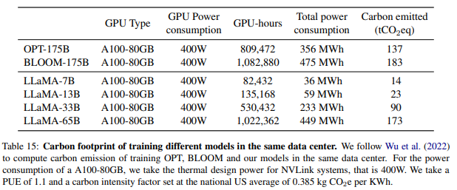
탄소
발자국
Carbon footprint
The training of our models have consumed a massive quantity of energy, responsible for the emission of carbon dioxide.
Watt-hour: Wh,
carbon emissions: tCO2eq
Power Usage Effectiveness (PUE) : 1.1.
Wh = GPU-h × (GPU power consumption) × PUE
tCO2eq = MWh × 0.385.
for a period of approximately 5 months
used 2048 A100-80GB
2,638 MWh
total emission of 1,015 tCO2eq
29

Slide 30
결론
Conclusion
LLaMA-13B outperforms GPT-3 while being 10× smaller, and LLaMA-65B rivals Chinchilla-70B and PaLM-540B.
Our models are trained solely on publicly available datasets, demonstrating that closed data is not essential for state-of-the-art results.
We hope open-sourcing LLaMA accelerates LLM research and supports work on robustness, bias, and toxicity.
Instruction finetuning, as shown in our preliminary results, yields promising improvements.
We plan to release even larger models trained on larger corpora in future work.
30

Slide 31
마무리
감사합니다.
31

